Slide 1

MBA CASE STUDY
AI Assistants for IT HelpDesk Automation
Implementing AI-Driven IT Service Management
in a Corporate Environment
Course: AIB913 – Case Studies in AI for Business | Khaled Khalefa | 23227103
Supervised by Prof. Ahmed ElSeddawy
Vice Dean of Educational Affairs- Smart Village
Ahmed.Bahgat@aast.edu

Slide 2
Presentation Agenda
01
Project Scope & Business Context
05
ERP Integration
Industry background and the problem being solved
Connecting AI with the Odoo ERP system
02
AI Solution Overview
06
Business Impact
Technologies deployed: NLP, ML, Generative AI, RPA
Financial, operational, and strategic value
03
Analytical Techniques
07
Risks & Ethics
Data types, ML models, and analytical methods used
Privacy, bias, adoption risk, and limitations
04
System Architecture
08
Recommendations
How the platform is built and operates
Strategic roadmap and future capabilities

Slide 3
Project Scope & Business Problem
What problem does this system solve?
🏢 Business Context
⚠️ Gap Analysis
▸ IT Service Management (ITSM) for medium-to-large organization
Operational
High MTTR & inconsistency
Slow, expert-dependent diagnostics
▸ Hundreds to thousands of networked devices across multiple zones
▸ Competitive market: ServiceNow, Zendesk, Freshdesk — but none offer proactive AI
Strategic
Purely reactive operations
No predictive maintenance
▸ 60%+ of helpdesk queries involve previously-seen issues (Gartner 2024)
Financial
Accumulated productivity loss
▸ Remote work has expanded device estates beyond traditional equipment
Avoidable downtime
Knowledge
Technicians reinvent solutions
No institutional knowledge capture

Slide 4
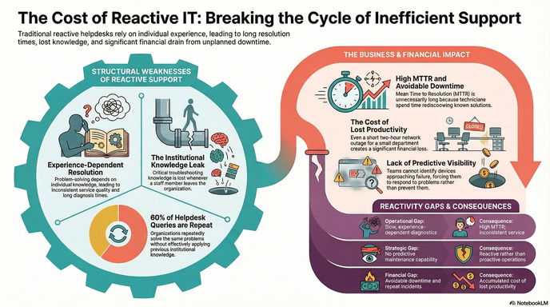

Slide 5
AI Solution Overview
Three core AI technologies working together
💬
Natural Language Processing(NPL)
🤖
Machine Learning(ML)
• Classifies ticket text automatically
• Supervised: ticket classification & priority
• Speech-to-text for verbal reports
• Unsupervised: anomaly & pattern detection
• 24/7 chatbot for user queries
• Semi-supervised: works on partial data
• Routes tickets to correct team
• Recommendation engine for resolutions
✨
Generative AI
⚙️
Robotic Process Automation(RPA)
• 'Thinking Mode' diagnostic plans
• Auto-assigns tickets on creation
• Step-by-step repair guidance
• Password resets without technician
• Illustrated equipment diagrams
• Firmware update scheduling
• Context-aware recommendations
• Device status syncs automatically

Slide 6
Development Methodology
Agile SDLC with 2-week sprints
📋
Planning
✏️
Design
💻
Development
Activities:
Business problem analysis, stakeholder interviews
Activities:
System architecture, DB schema, AI model selection
Activities:
AI model training, ticketing logic, ERP integration
Outcome:
Agreed scope & success criteria
Outcome:
Technical blueprint & workflow diagrams
Outcome:
Working prototype with core features
🧪
Testing
🚀
Deployment
🔄
Maintenance
Activities:
Model accuracy validation, user acceptance testing
Activities:
Cloud rollout, staff onboarding, data migration
Activities:
Continuous model retraining, bug fixes, feature updates
Outcome:
Verified system performance benchmarks
Outcome:
Live production system
Outcome:
Improving accuracy over time

Slide 7
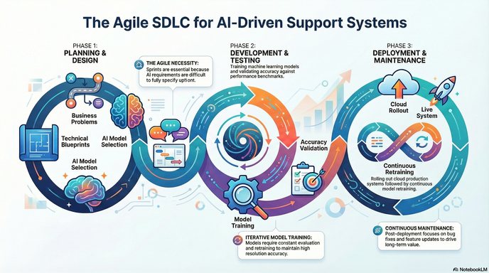

Slide 8
3. Analytical Techniques
Data Types · Analytics Framework · Key Performance Indicators
3.1 Data Types & Sources
3.2 Analytics Framework
Structured
Descriptive · What happened?
Device inventory, ticket records, SLA parameters, technician rosters
Ticket volume, device downtime, resolution rates
Unstructured
Diagnostic · Why did it happen?
Ticket descriptions & voice-to-text transcripts (processed by NLP)
Root cause linking ticket spikes to firmware updates
Real-Time
Predictive · What will happen?
Network scanner: continuous device monitoring & instant status updates
Detecting devices with failure patterns statistically
Historical
Prescriptive · What should we do?
Full case archive — descriptions, diagnostics & resolutions — powering ML
Recommending resolution workflows from device history

Slide 9
KPIs & Data Mining
Performance Metrics · Decision-Support Techniques
Data Mining Techniques
Classification
Routes incoming tickets to predefined categories automatically
Clustering
Groups devices & incidents by similarity to surface systemic patterns
Association Rules
Finds factor combinations (age + load + time) co-occurring with faults
Anomaly Detection
Flags statistical outliers before users report a problem
Technicians are not replaced — their decision-making is informed and accelerated.

Slide 10
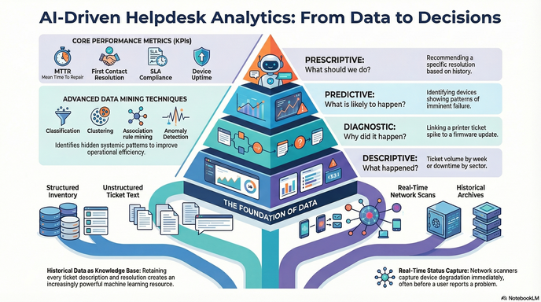

Slide 11
System Architecture & Workflow
How a support ticket flows through the AI platform
1
2
3
4
5
6
7
Issue Reported
AI Classification
Device Lookup
Diagnosis
Resolution
Data Sync
Model Update
Text, voice, or chatbot
Category, priority & routing
ERP inventory history
AI recommendations generated
Technician applies & documents
Outcome written to ERP
ML retrained on new data
Data Sources Used
▸ Structured: Device inventory, ticket records, SLA parameters, rosters
▸ Unstructured: Ticket text, technician notes, user voice descriptions
▸ Semi-structured: SNMP device logs, API responses, diagnostic scan outputs
▸ External: Vendor technical docs, knowledge base articles

Slide 12
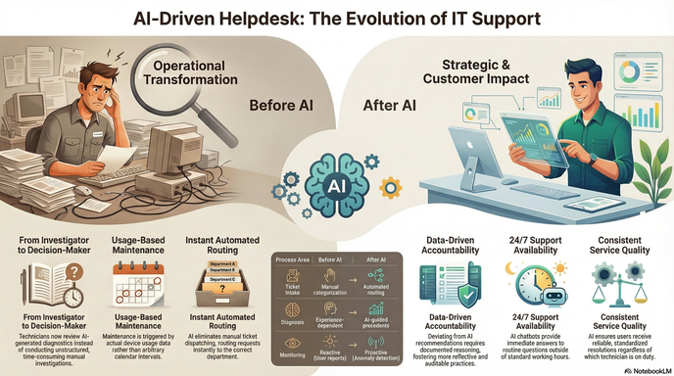

Slide 13
ERP Integration with Odoo
Connecting AI intelligence with enterprise data
📦
Inventory Module
🎫
Helpdesk Module
Device records, serial numbers, IP addresses, maintenance history
Ticket lifecycle, SLA tracking, technician workload management
💰
Accounting Module
👥
HR Module
Downtime cost tracking, maintenance budgets, ROI reporting
Technician skills, staffing, training needs from ticket data
⚡ Implementation Challenges
• Data Quality: Historical ERP records were incomplete — significant cleansing needed before ML training
• Customisation: Standard Odoo modules needed bespoke development for bidirectional synchronisation
• User Resistance: Some staff preferred logging directly in ERP — change management was essential

Slide 14
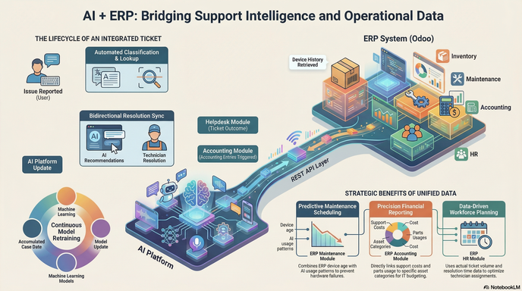

Slide 15
Business Impact & Value Creation
The measurable outcomes of deploying Helpdesk Support AI
25–40%
3 Days
60%+
Reduction in MTTR
Technician time freed per week (team of 10)
Tickets involve previously seen issues
IBM AI Operations Report 2023
30% resolution time saving
Gartner ITSM Report 2024
💲 Financial
⚙️ Operational
📈 Strategic
• Reduced labour on routine tickets
• Higher SLA compliance through auto-escalation
• Growing data asset that compounds over time
• Lower downtime costs via faster resolution
• Even technician workload distribution
• Foundation for autonomous incident resolution
• Fewer repeat incidents as knowledge base grows
• New staff become productive faster
• Ready for predictive procurement and planning

Slide 16
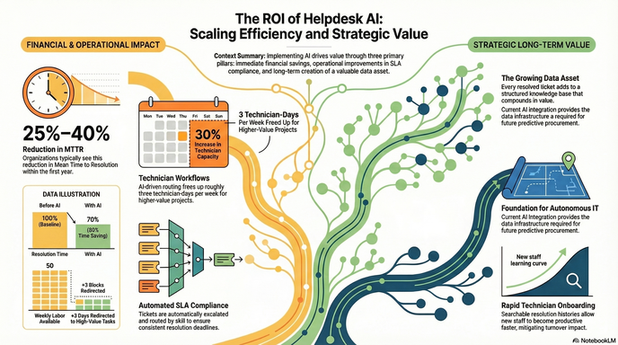

Slide 17
Risks, Ethics & Limitations
Key considerations for responsible AI deployment
🔒 Data Privacy & GDPR
🛡️ ISO 27001 – Access Control
• Tickets identify users; network scans reveal location
• Role-based access: admin, technician, standard user
• Voice transcripts may capture sensitive conversations
• Admin accounts must use multi-factor authentication
• Must inform users of data collection and retention
• All access events logged and retained for audit
• All data in transit must be encrypted
• Access rights reviewed on staff role changes
⚖️ AI Bias Risk
🚧 Adoption & Limitations
• Models learn from historical data — bias is inherited
• Technicians may bypass the AI and revert to old habits
• Underrepresented device types get poorer predictions
• Change management and early wins are essential
• Regular performance audits across ticket sub-categories
• AI outputs are predictions, not definitive diagnoses
• Targeted retraining where disparities are found
• Novel problems still require experienced human judgement

Slide 18
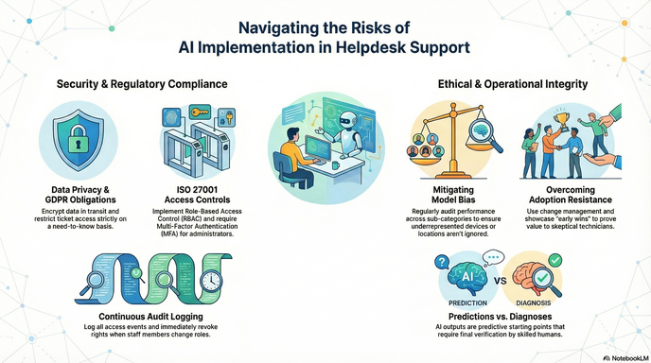

Slide 19
Recommendations & Future Scope
Strategic advice and next-generation capabilities
📌 Strategic Recommendations
🔭 Future Capabilities
1
Invest in data quality BEFORE deploying AI — clean historical records are essential
▶ Predictive intelligence: flag devices likely to fail days in advance
2
Treat change management as equally important as technical implementation
▶ IoT sensor integration for server room and hardware monitoring
3
Establish a data governance framework from day one with clear ownership
▶ AI-driven procurement: auto-generate POs before shortages occur
🔗 ERP & AI Expansion Roadmap
Procurement AI:
Budget Forecasting:
Workforce Planning:
Analyses consumable patterns → auto-purchase recommendations before stock runs out
Predicts future IT support costs based on device estate age profile
Uses ticket volume forecasts to recommend optimal staffing levels

Slide 20
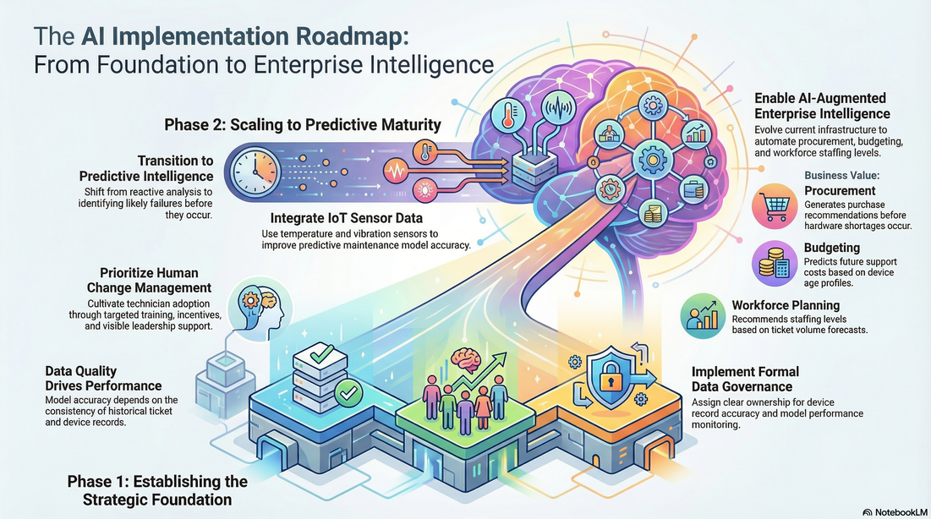

Slide 21
Key Takeaways
🎯
The Problem:
Traditional helpdesks are reactive, knowledge-siloed, and inefficient — causing avoidable cost and downtime
🤖
The Solution:
AI (NLP + ML + GenAI + RPA) transforms the helpdesk into a proactive, intelligent support command centre
💼
The Value:
25–40% MTTR reduction, even workload distribution, SLA compliance, and a compounding data asset
⚠️
The Responsibility:
Data privacy (GDPR), ISO 27001 access control, bias auditing, and strong change management are non-negotiable
MBA Case Study | AIB913 – AI for Business | Khaled Khalefa | 23227103

Slide 22


